Slide 1
Desktop Alarm Software
Nov 26, 2018

Slide 2
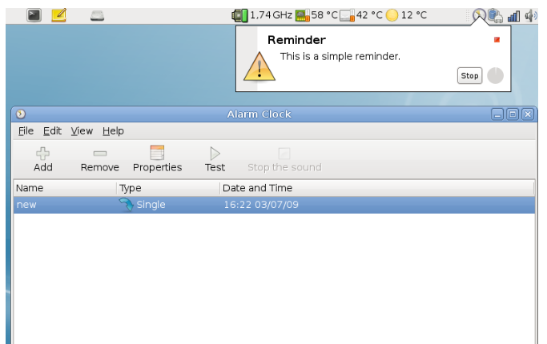
1. User Interface
Balloon tooltip on the notification area of the task bar.

Slide 3
2. Setting
It could be configured following things.
- Launch on start up
- User account
- Server settings (IP)
- Shape of the alarm

Slide 4
3. Communication with server
My suggestion:
VS
Your Idea:
ERP Server
Client
ERP Server
Client
Alarm
ERP API
Alarm
Call API
Timer
ERP API
Call API
Call API
API
Return result
Get Result
Broker
Send Result
Timer

Slide 5
4. Security
We can use basic HTTPS Authentication mechanism with user account.
ERP can have the user account db.
User can set his account on his alarm after installed it.

Slide 6
5. Other
Language : Python
GUI Package : PyQT or Kivy
System : Ubuntu (Linux), Windows and Mac

